Slide 1
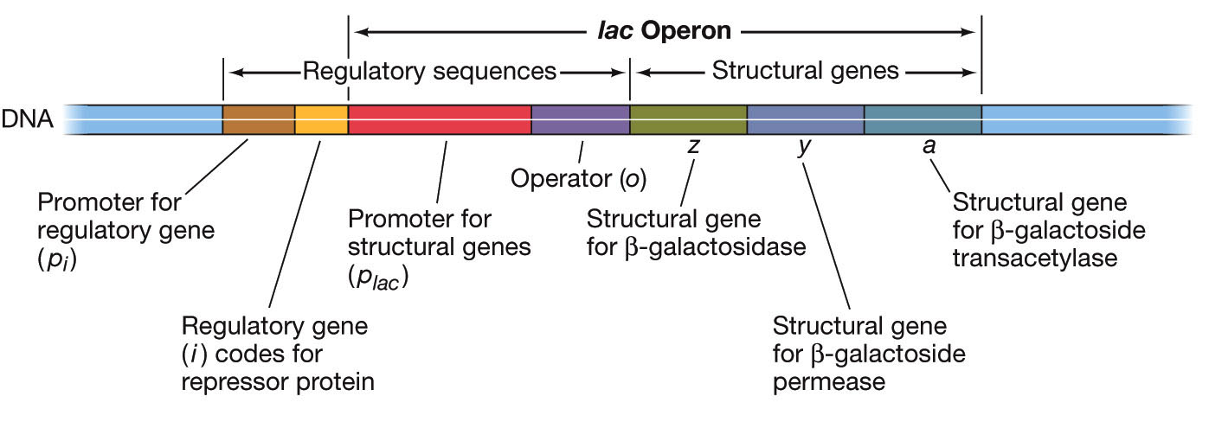
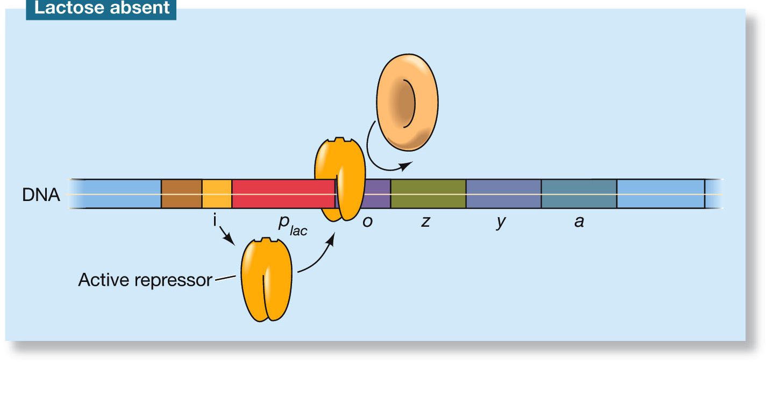
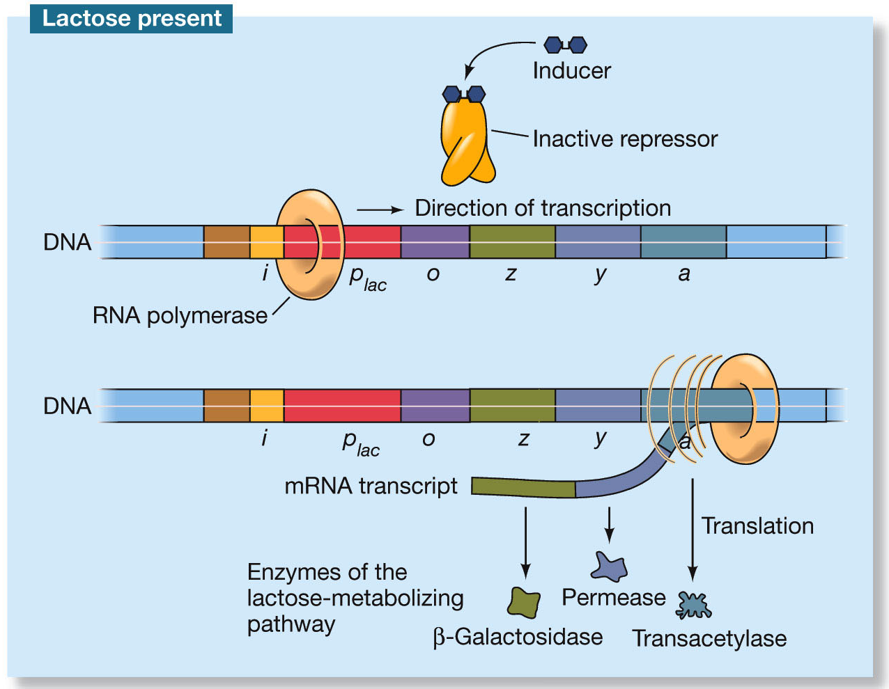
Intro to Biotech
Lect.11
Prokaryotic gene regulation
- operons
-
RNA pol
Lac Operon –
-

Slide 2
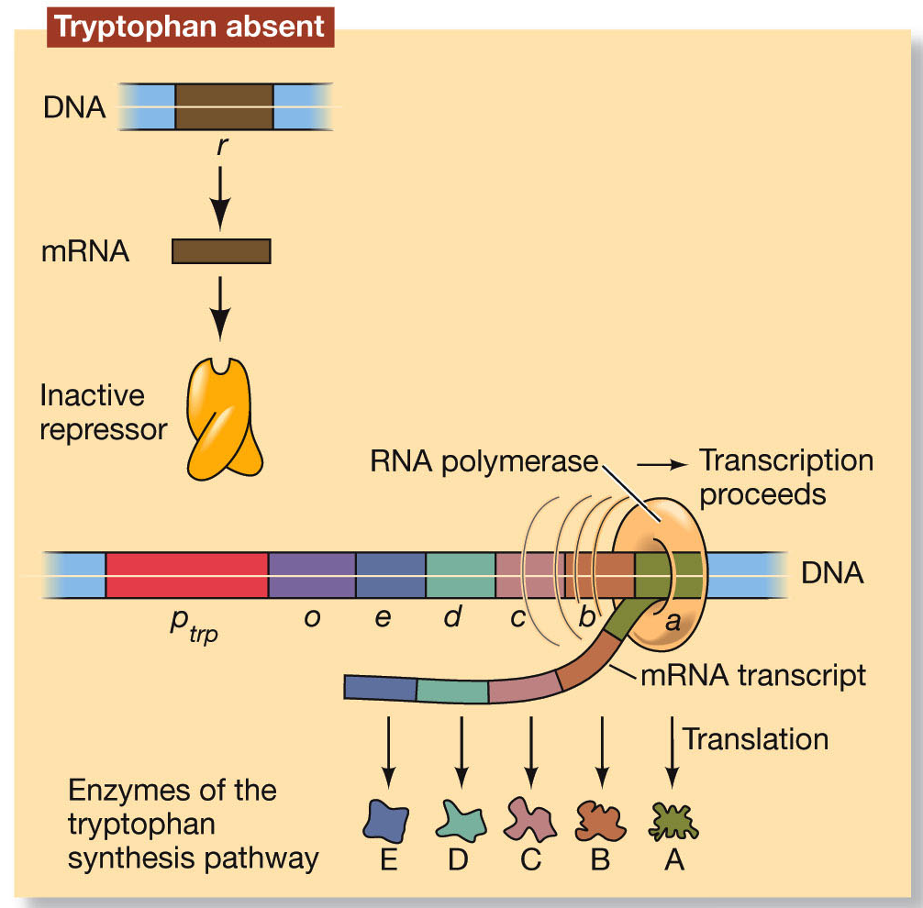
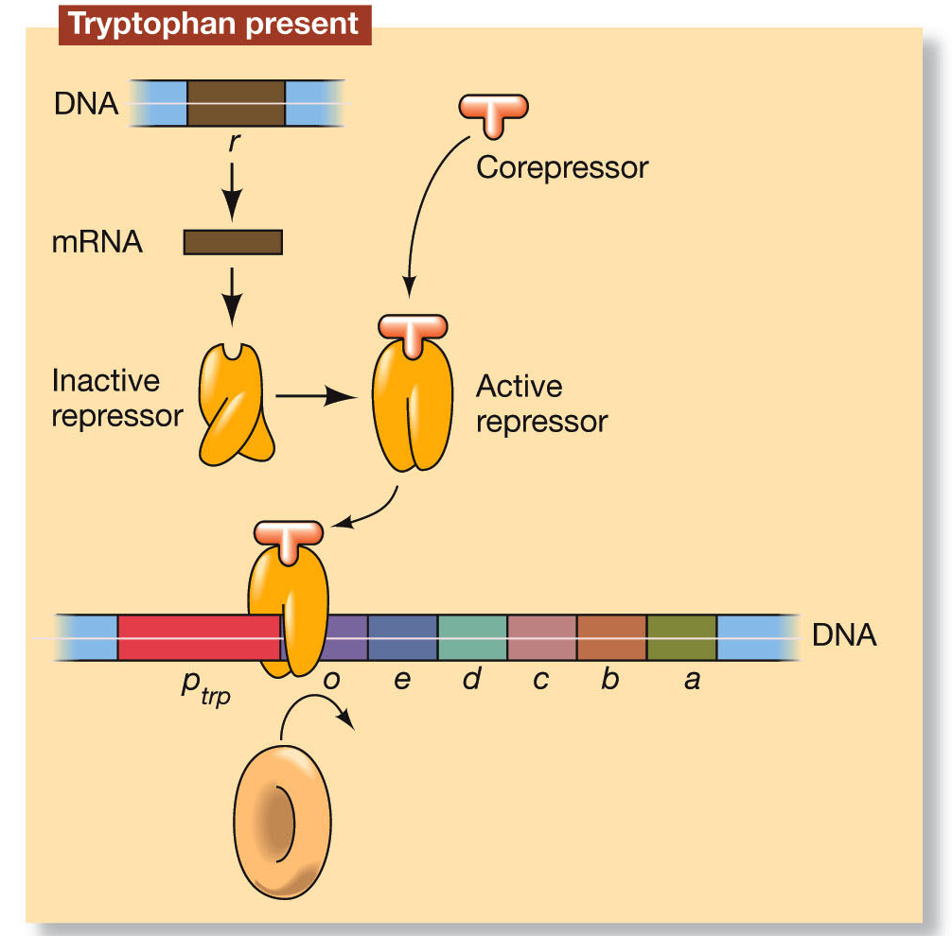
Intro to Biotech
Lect.11
Prokaryotic gene regulation
Genomes:
- inducible vs repressible
Trp Operon –
-
Trp
Trp =

Slide 3
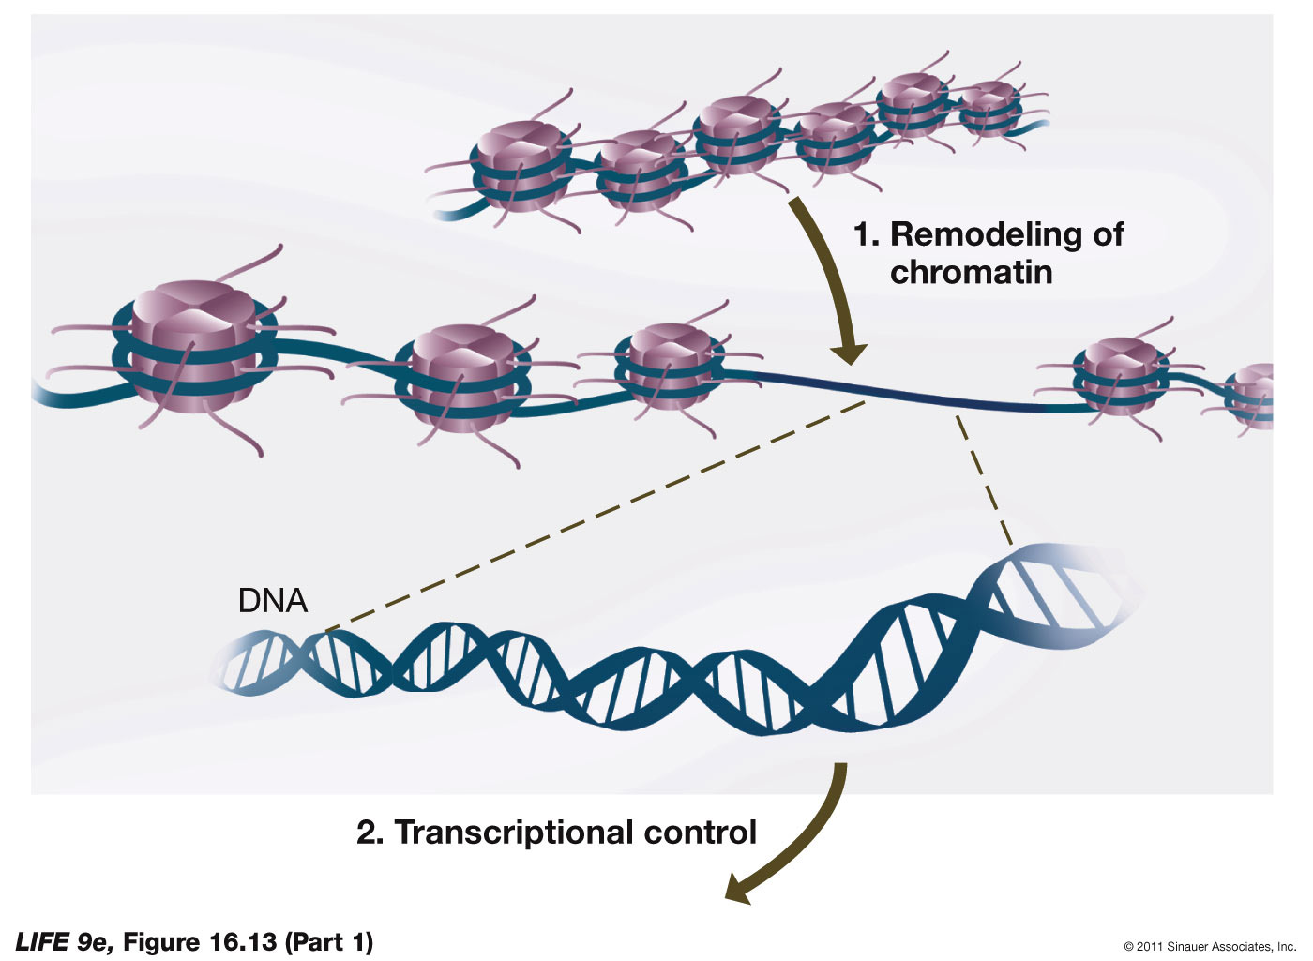
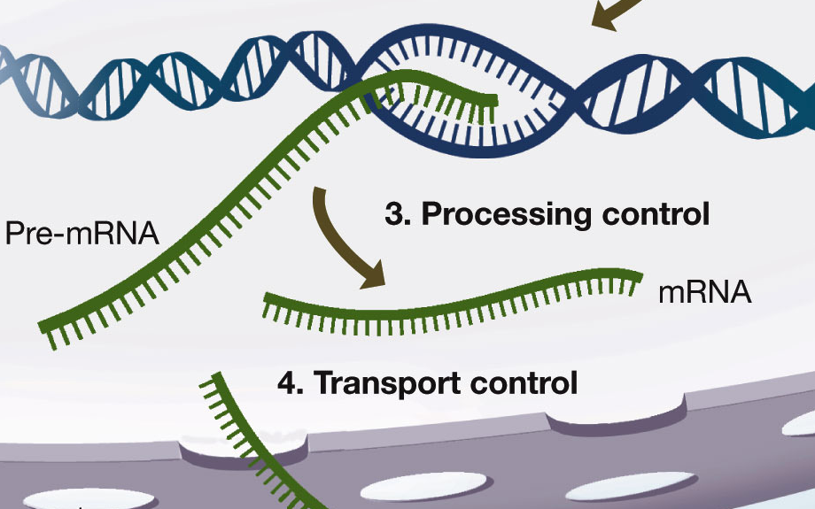
Intro to Biotech
Lect.11
Eukaryotic gene regulation
How do we define eukaryotic genes and their function?
RNA
Gene transcript
protein
Gene structure
Transcription unit:
• exons – 5’ UTR, ORF, 3’UTR
• introns
Regulatory elements:
•
•
•
Regulation:
• transcriptional
• posttranscriptional

Slide 4
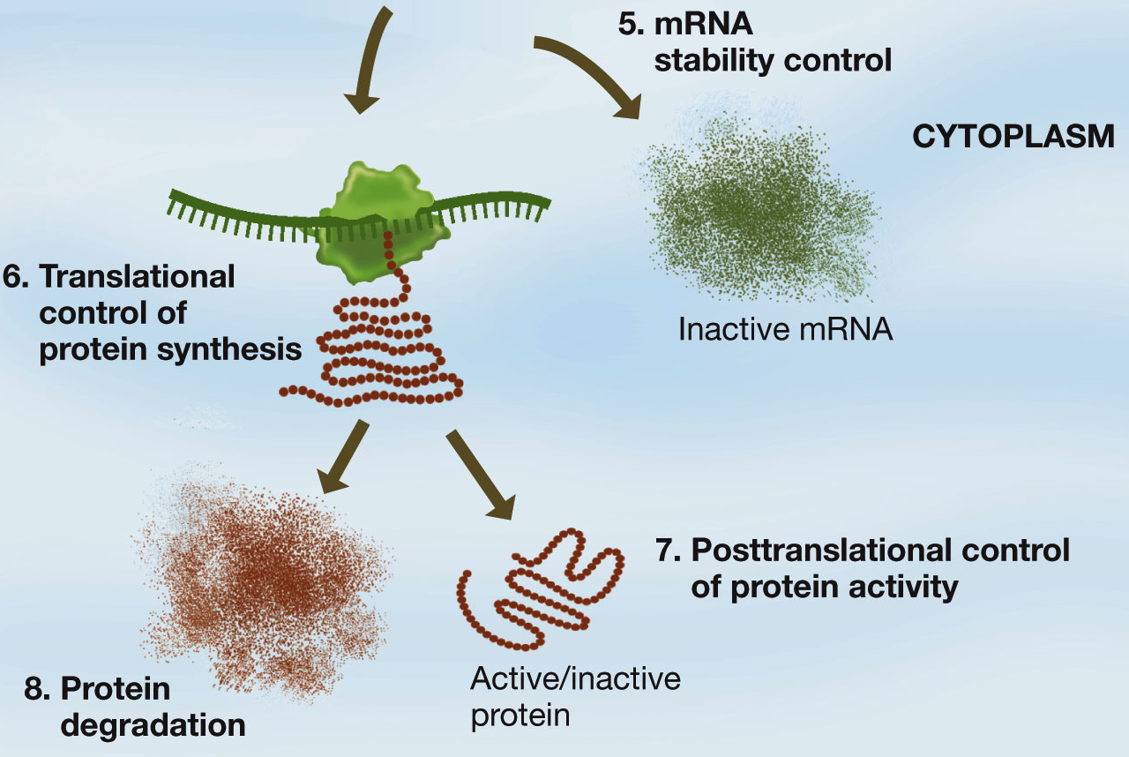
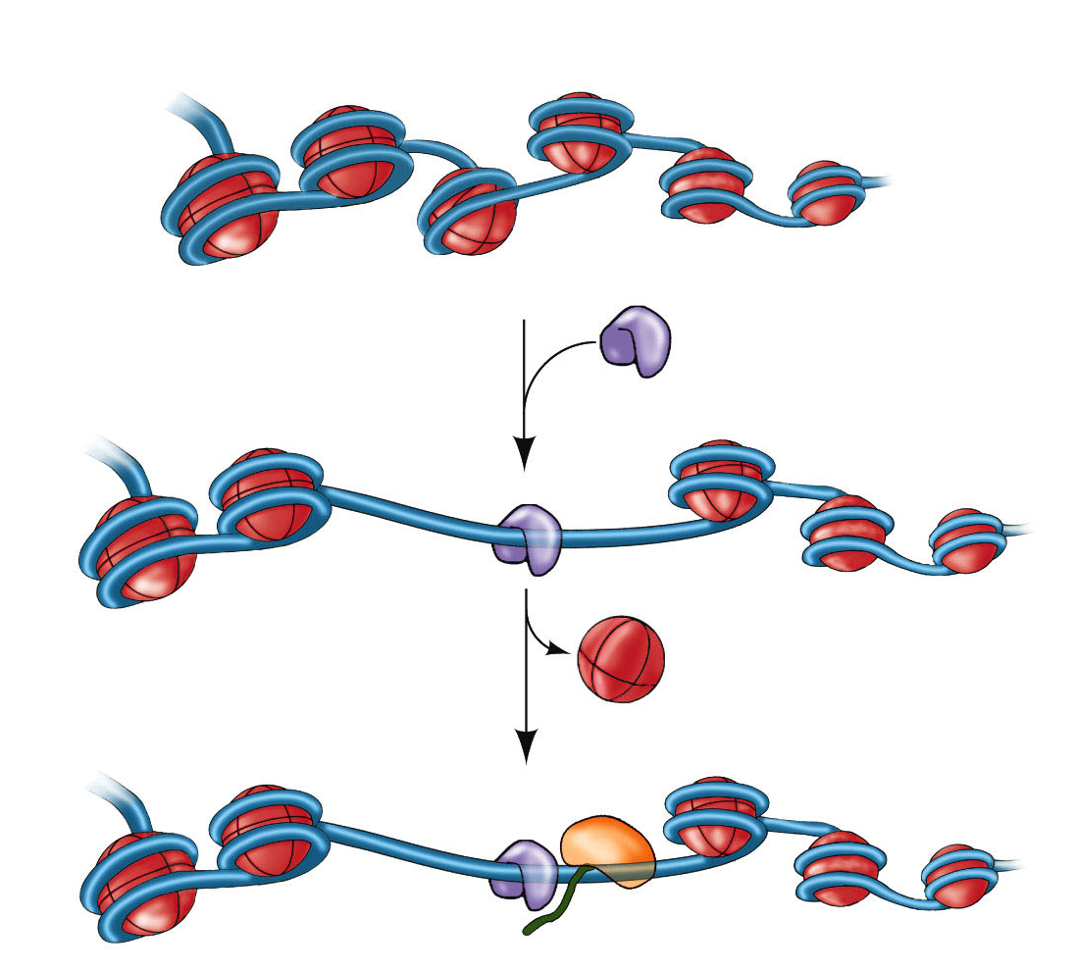
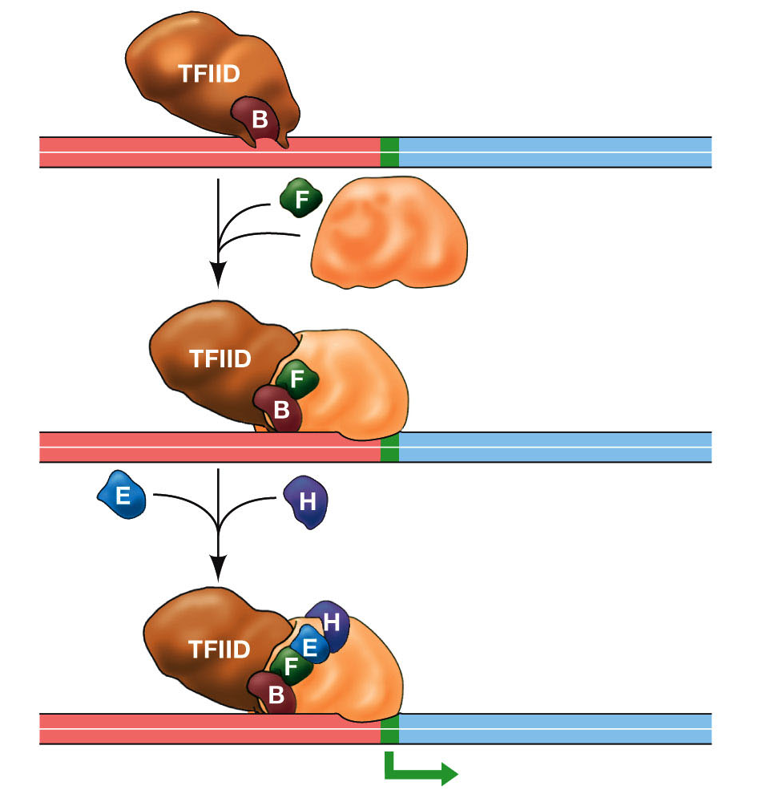
Intro to Biotech
Lect.11
Eukaryotic gene regulation
Regulation:
• transcriptional
• posttranscriptional
• translational
• posttranslational
• transcriptional
Enhancers -

Slide 5
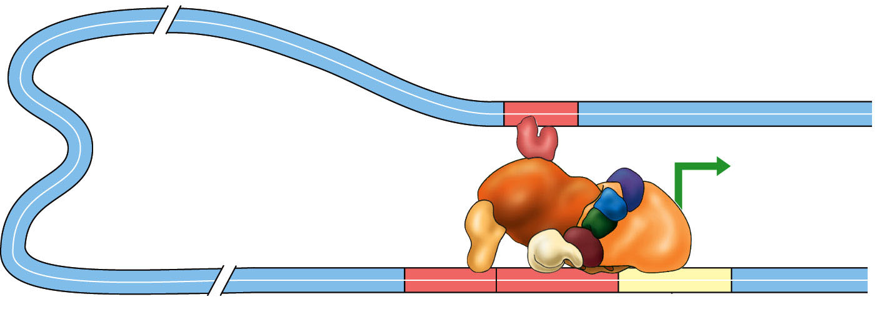
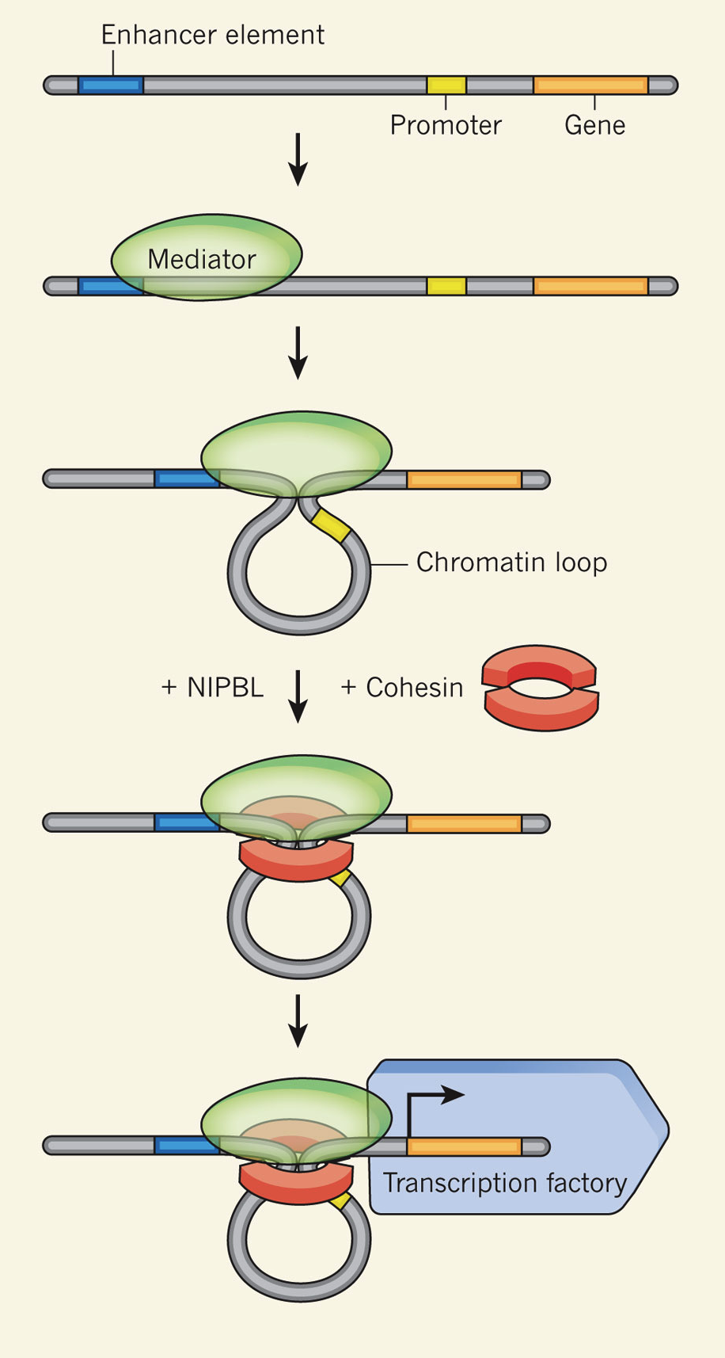
Intro to Biotech
Lect.11
Eukaryotic gene regulation
Gene regulation:
-
-

Slide 6
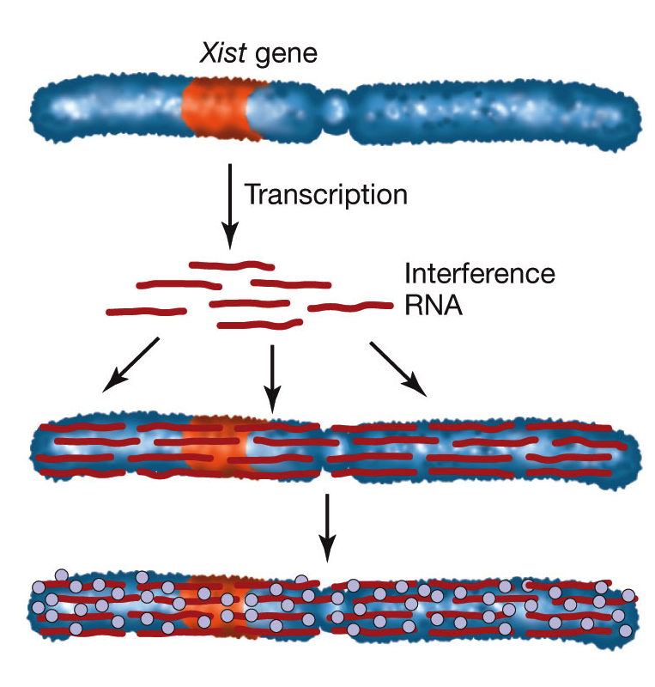
Intro to Biotech
Lect.11
Eukaryotic gene regulation
Euchromatin:
Heterochromation:
Regulation:
• transcriptional:
• X inactivation

Slide 7
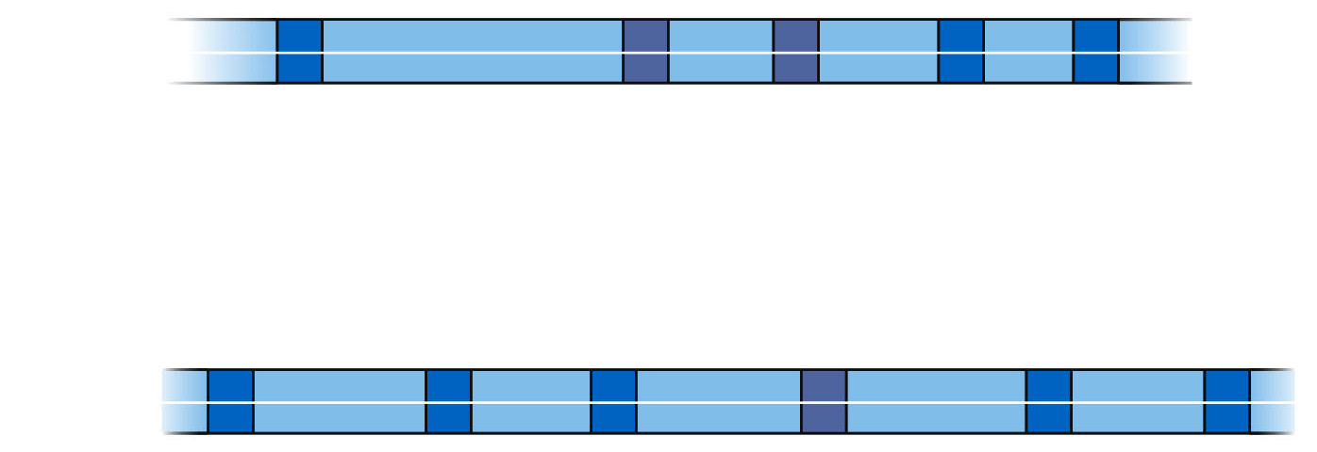
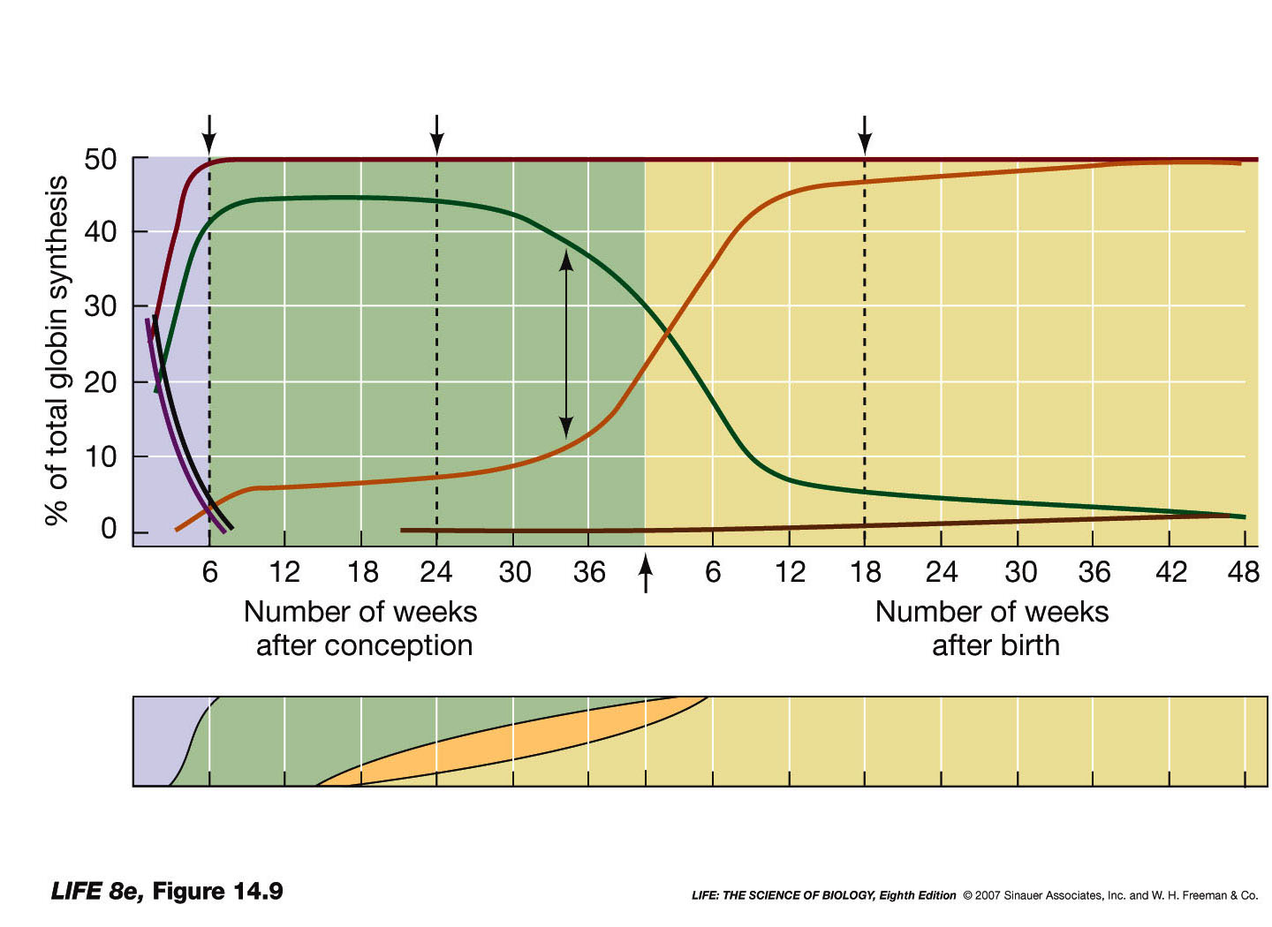
Intro to Biotech
Lect.11
Regulation:
• transcriptional (1,2)
- genes
alpha
beta
6-week-old
fetus
24-week-old
fetus
18-week-old
baby
α
β
ε
γ
ζ
δ
Fetal liver
Bone marrow
Fetal yolk sac
Fetal spleen

Slide 8
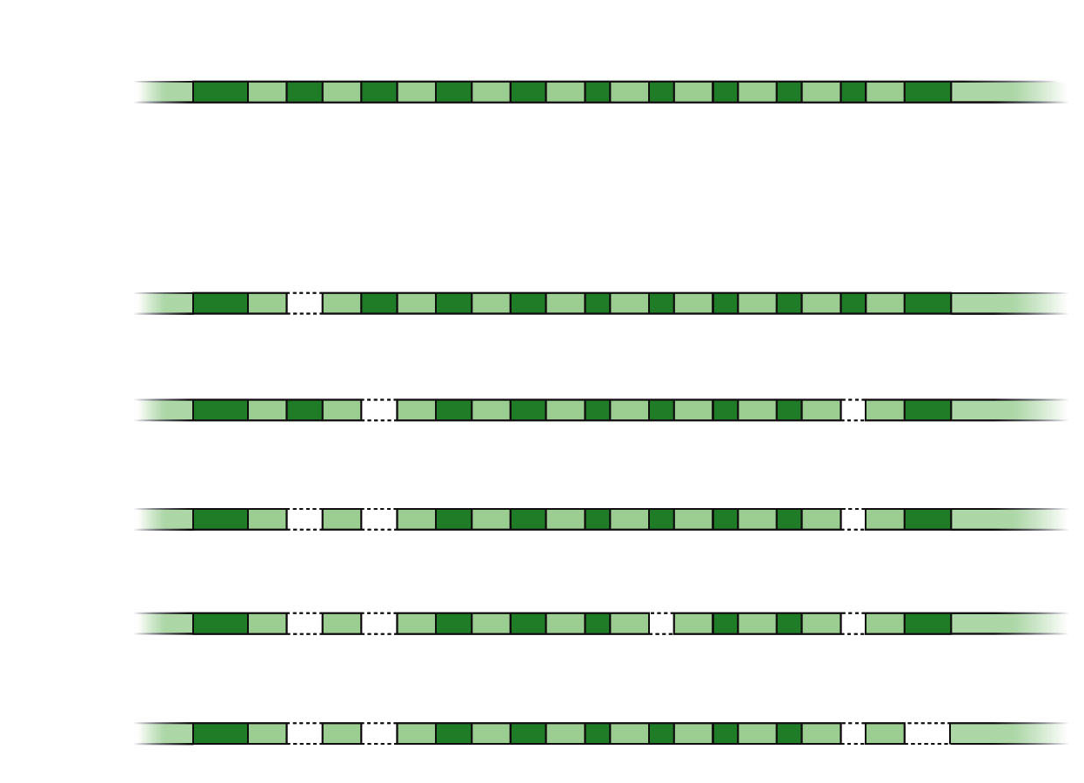
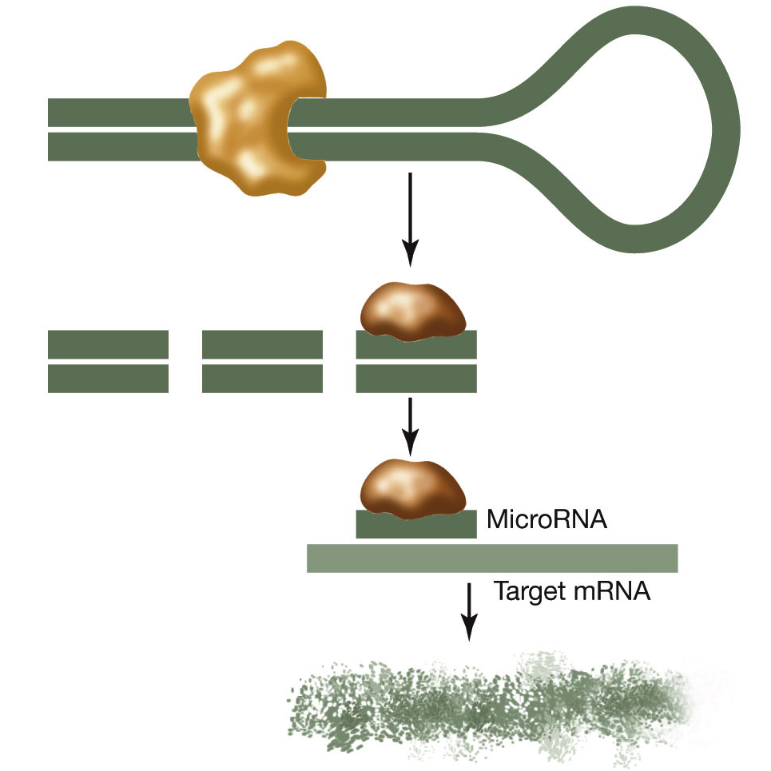
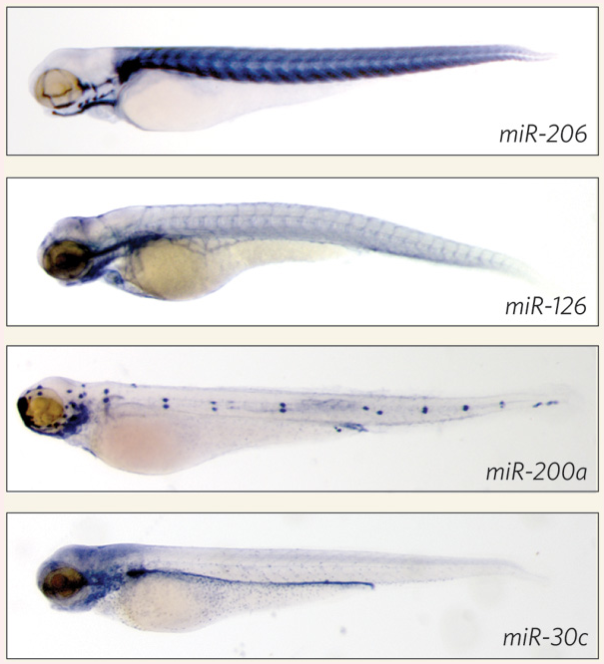
Intro to Biotech
Lect.11
Regulation:
• transcriptional
• posttranscriptional (3,4)
-
Primary RNA
transcript for
tropomyosin: 11 exons
Skeletal muscle:
missing exon 2
Smooth muscle:
missing exons 3
and 10
Fibroblast: missing
Exons 2, 3, and 10
Liver: missing
exons 2, 3, 7, and 10
Brain: missing
exons 2, 3, 10,
and 11
-

